Slide 1
Tropospheric Zonal Wind And Temperature Profiles
Mihir Dasgupta
Advised by Prof. Jai Sukhatme, Centre Of Atmospheric Sciences, Indian Institute of Science, Bangalore

Slide 2
Energy and Temperature In The Troposphere
Why is it so cold at the Poles?
Why is it so warm at the Equator?
Why does temperature decrease higher up?
Is the equator the warmest place on the planet?
Why do we have such prominent seasons?
Why does the air thin at higher altitudes?

Slide 3
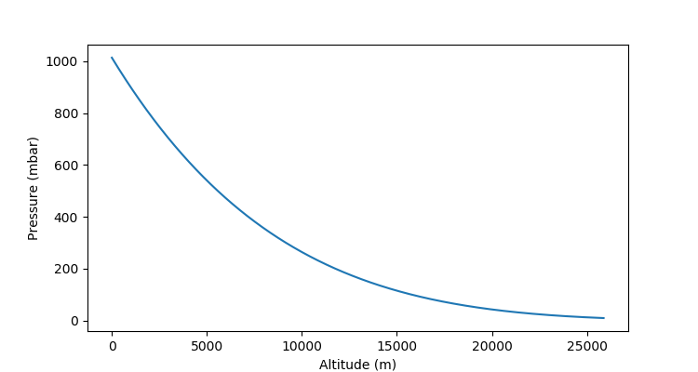
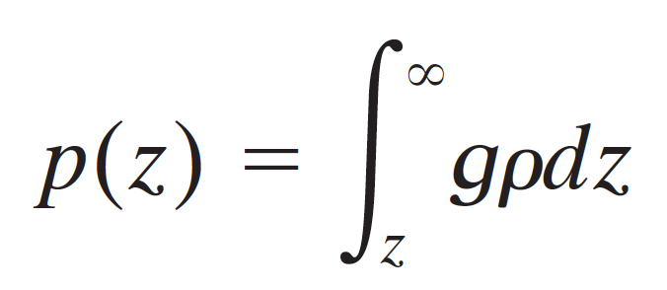
Air Pressure vs. Altitude
Air pressure at any altitude is equal to the weight of the vertical column above it

Slide 4
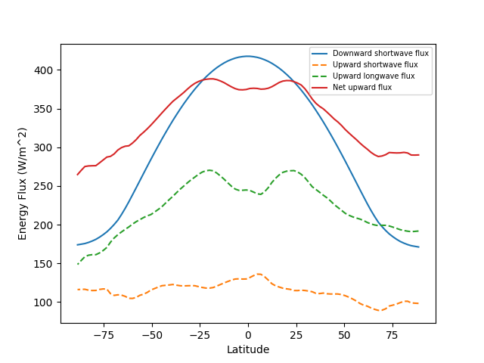
The Energy Balance
Key takeaways:
Energy surplus at the equator
Energy deficiency at the poles
Winds help in the transport of energy from equator to poles

Slide 5
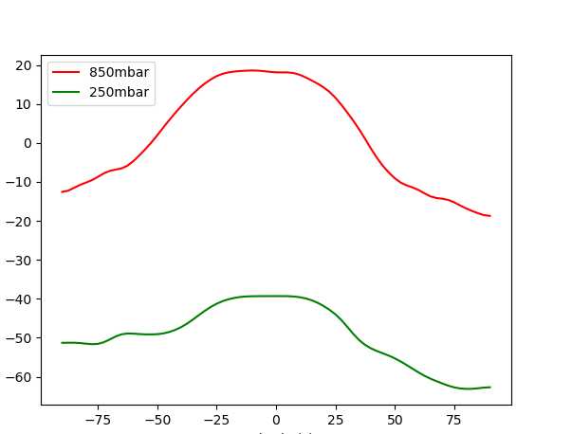
Latitudinal Temperature Profile
Latitudinal progression similar to insolation profile from energy balance
Mitigation:
Polar influence
Wind action
Why does temperature decrease as we move away from the equator?
The solar zenith angle increases as we move towards the Poles. Therefore, a unit energy input is spread across a larger surface area

Slide 6
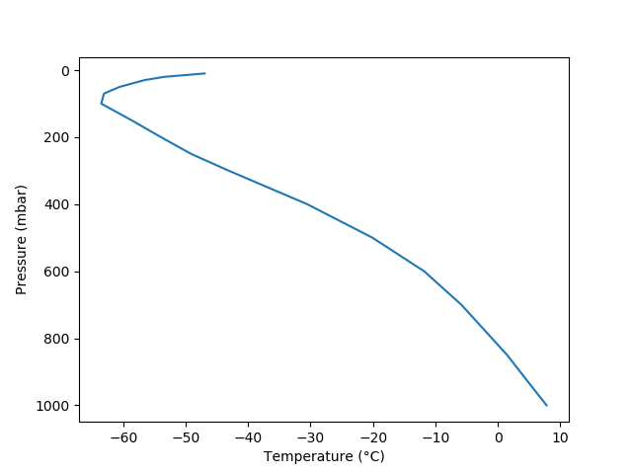
Altitudinal Temperature Profile
Adiabatic expansion with altitude reflected by the observed negative gradient
Tropospheric lapse rate is negative
The inversion marks an estimated tropopause height

Slide 7
Why does temperature decrease with height?
Adiabatic Cooling
Adiabatic process: A thermodynamic process without any transfer of temperature or mass between a system and its environment
A warm parcel of air rises and expands due to the reducing pressure of its environment.
There is no transfer of heat, so the work done by the parcel translates to a reduction of temperature in the system.

Slide 8
How does Earth's axial tilt factor in?
β
α

Slide 9
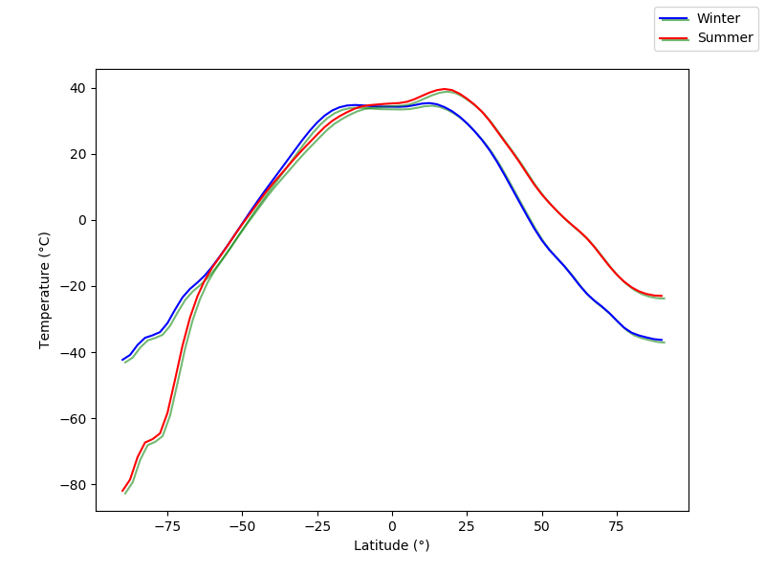
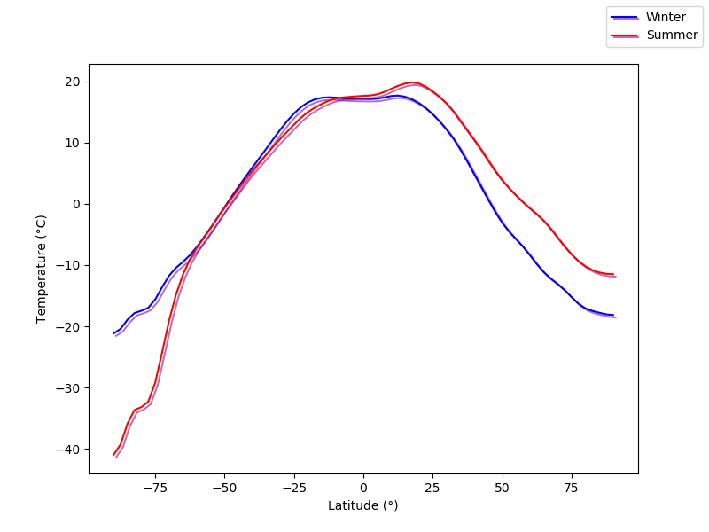
Seasonal Temperature Differences
The tilt of the Earth's axis induces seasonal changes in insolation
Cryospheric influence near the Southern Pole create observed increased temperature differences
850 mbar profile
250 mbar profile

Slide 10
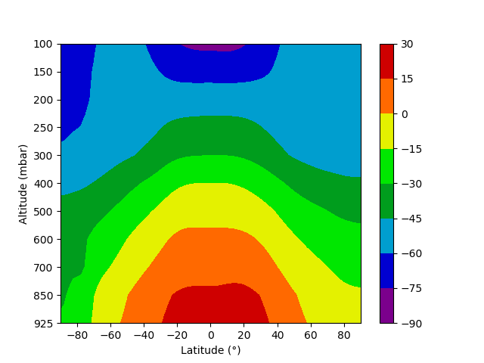
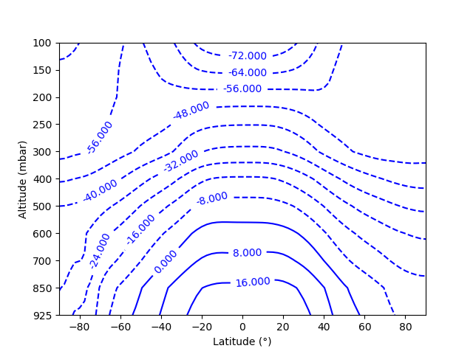
Contour Mappings Of Temperature

Slide 11
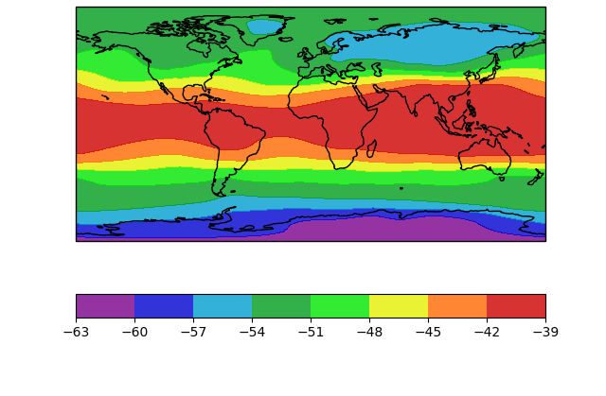
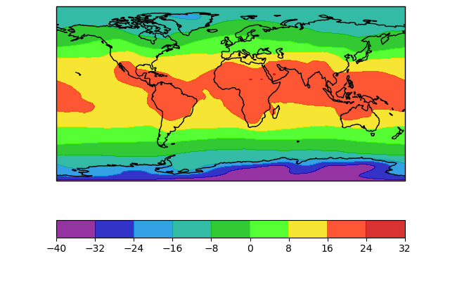
Equirectangular Projections
250 mbar
850 mbar

Slide 12
Zonal Winds In The Troposphere
Why is wind so strong in the east-west direction?
Why do planes fly in the stratosphere?

Slide 13
The Coriolis Effect
Our measurements of atmospheric dynamics are made in a non-inertial frame of reference
We cannot perceive the Earth's rotation
While measuring wind travelling in the north-south direction, we must consider a lateral deflection
The magnitude and direction of this deflection is dependent on the latitude of the air parcel

Slide 14
An explanation for the Coriolis Effect
The Earth rotates in an eastward direction
A stationary air parcel near the Equator rotationally travels eastward faster than one at a higher or lower latitude.
Therefore, if subjected to southerly transport, it travels at a relatively higher eastward velocity
This component is derived from the Earth's rotation- a phenomenon that we cannot accurately account for from our frame of reference.

Slide 15
The General Circulation
The Hadley model serves to describe an estimated prediction of tropospheric winds
Due to the Coriolis effect, wind has a significant east-west component
This component is exploited to examine prevailing winds
The model splits up the global circulation into a set of simple closed circulations called cells.
The magnitude of the wind in each cell is determined by the temperature differences that drive it.

Slide 16
Cell activity
Surface-level view

Slide 17
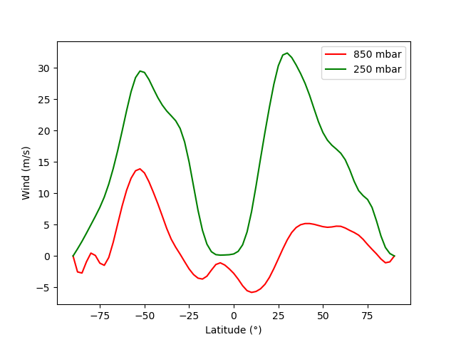
Latitudinal Zonal Wind Profile
Describes the progression of the 3 prevailing winds: Trade Winds, Westerly Jet Streams and Polar Easterlies
Positive values correspond to a westerly wind (and vice-versa)
Jet stream significantly stronger

Slide 18
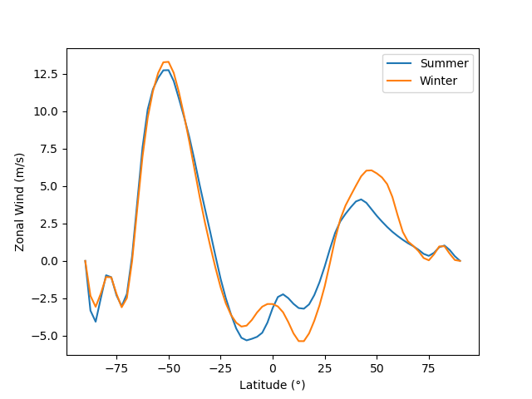
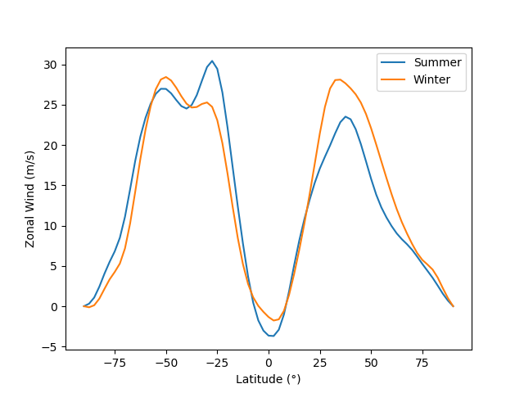
Seasonal Differences
As explained previously, temperature differences are higher in winter. Hence, we see stronger zonal wind during these seasons
850 mbar
250 mbar

Slide 19
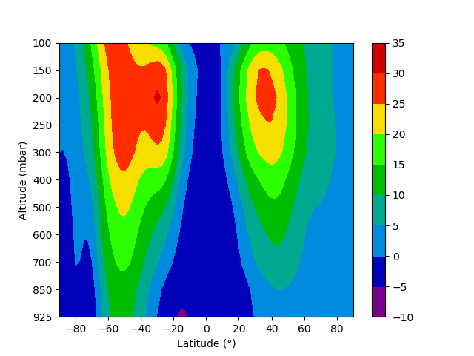
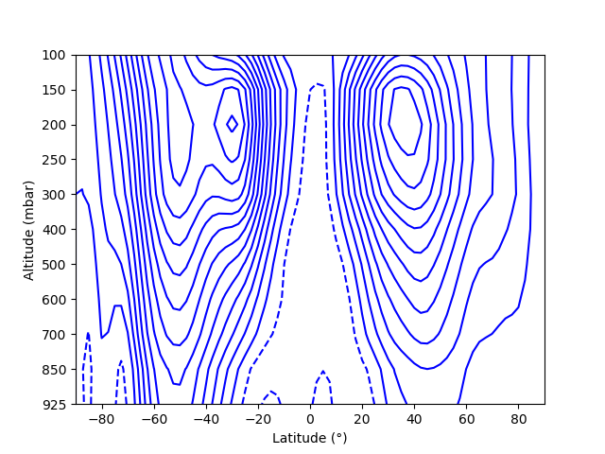
Contour Mappings Of Zonal Wind

Slide 20
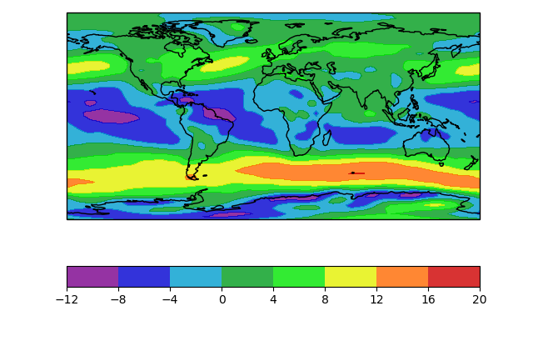
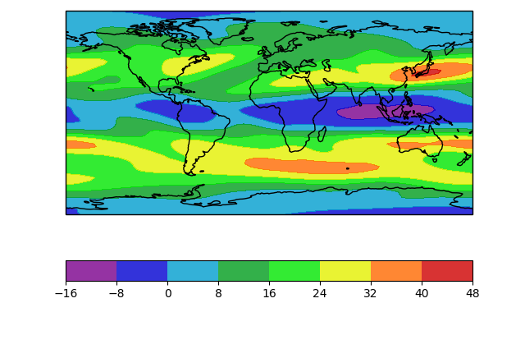
Equirectangular Projections
850 mbar
250 mbar

Slide 21
Bringing them together
How do wind and temperature work in conjunction?
How do we use temperature profiles to derive a wind field?

Slide 22
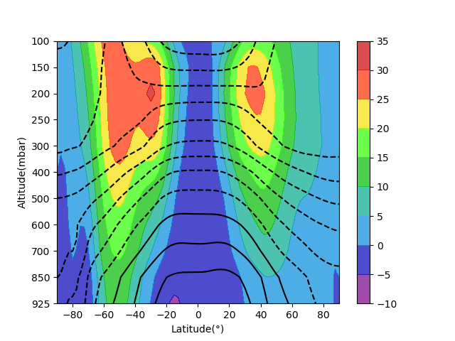
Thermal Wind
Thermal Wind: Difference in wind velocity over a short path.
Flows parallel to isotherms (regions of constant temperature)
A thermal wind field allows us to estimate higher winds (if we have a map of pressure contours)

Slide 23
Data And Algorithms
How do we measure climate variables?
What's the challenge there?
How do we predict weather?

Slide 24
Reanalysis Data
Retrospective Analysis
Mainly serves to improve existing estimations of the past states of the atmospheric-ocean system.
Combines corroborated models and recorded data in an effort to accurately determine climate variables.
Issues that reanalysis address:
Validity of older data
Quality control of recorded data
Long-term climatological means

Slide 25
Data Structures
A
Most basic data is recorded in 4 dimensions – Spatial coordinates over time
The primary data structures used in datasets we used are trees
A.A
A.B
A.B.a
A.B.b
A.A.a
A.A.b

Slide 26
Example: Contour Plots
Height
Latitude
Longitude

Slide 27
Height
Time
Latitude

Slide 28
Height
Latitude

